Slide 1
Standing Orders in Alma
Yoel Kortick
Senior Librarian

Slide 2
Agenda
Background
The Standing Order
The Ten Steps of a Standing Order
The Standing Order – A Live Demo
The Standing Order for Electronic Resources

Slide 3
Background

Slide 4
Background
There are three types POL (Purchase Order Line) continuity types:
  One‐time
  Continuous
  Standing order

Slide 5
Background
This presentation will focus specifically on continuity type “Standing order”
In order to understand the context of the standing order within the “larger picture” we will first very briefly discuss the “One Time” and “Continuous” continuity types.

Slide 6
Background
One-time continuity type
Used for one‐time or infrequent orders
Examples:
  Printed book
  E‐book
  Musical scores (not published in a continuous manner)

Slide 7
Background
One-time continuity type – physical inventory
When the order is continuity type “One-time” and the inventory is physical the material is received via the One Time tab on the Receive New Material page.
Holdings and items are created automatically, with one holdings being created for each unique location, and one item for each copy.
Once the PO line is invoiced and received it is closed.

Slide 8
Background
One-time continuity type – electronic inventory
When the order is continuity type “One-time” and the inventory is electronic the material goes through the standard activation process
Once the PO line is invoiced and activated it is closed.

Slide 9
Background
Continuous continuity type – Physical Inventory
When the order is continuity type “Continuous” and the inventory is physical the material is received via the Continuous tab on the Receive New Material page.
Holdings are created upon PO line creation (for each run of the series in a location) and items are created either
  If a prediction pattern is used: When doing “Open predicted items”
  If a prediction pattern is not used: Upon receipt of the issue or bound volume
The PO line remains open once it is invoiced and received. It can be closed manually.

Slide 10
Background
Continuous continuity type – Electronic Inventory
When the order is continuity type “Continuous” and the inventory is electronic the material goes through the standard activation process and may be deactivated during the evaluation process.
The PO line remains open once it is invoiced and received/activated. It can be closed manually).

Slide 11
Background
POL Type | Inventory Receipt / Activation | Holdings and Items Creation | POL closure
One Time - Physical | Received via the One Time tab on the Receive New Material page. | Holdings and items are created automatically | Once the PO line is invoiced and received it is closed
One Time - Electronic | Goes through the standard activation process. |  | Once the PO line is invoiced and activated it is closed.
Continuous - Physical | Received via the Continuous tab on the Receive New Material page. | Holdings created upon PO line creation. Items created via prediction pattern or receipt of the issue. | The PO line remains open once it is invoiced and received. It can be closed manually.
Continuous - Electronic | Goes through the standard activation process and may be deactivated during the evaluation process. |  | The PO line remains open once it is invoiced and activated. It can be closed manually.

Slide 12
The Standing Order

Slide 13
The Standing Order – an introduction
A standing order is used for ordering material which is published from the same vendor in an irregular and unpredictable frequency.
In most cases the standing order is an “open order” for all titles that fit a particular category or subject.
The standing orders are placed for selected material for which it is important to ensure uninterrupted receipt of new editions or parts.

Slide 14
The Standing Order – an introduction
The standing order is useful because library staff members do not have to check continuously to see if new editions or parts have been published.
The vendor receives the standing order and knows that anything which meets the criteria of the order should be sent to the library.
Examples:
  Purchasing all the printed books by a particular author when they are published.
  A series of books which are not published on a regular basis.
  All pamphlets which a certain organization publishes.

Slide 15
The Standing Order – an introduction
With a standing order the physical material is not received on the Receive New Material page.
Physical monograph material is created manually by
  Creating or choosing a bibliographic record
  Creating a holdings record (if not already existing)
  Creating an item record
  Associating the item with the standing order POL.
  Setting the receipt date for the item in the Physical Item Editor.
  Paying for the item via the invoice line

Slide 16
Background “Summary of One Time and Continuous”
POL Type | Inventory Receipt / Activation | Holdings and Items Creation | POL closure
Standing Order - Physical | Not “received”. Created and linked to POL in the item. | Holdings and items are created manually. | The PO line is manually closed
Standing Order - Electronic | Goes through the standard activation process. |  | The PO line is manually closed

Slide 17
The Ten Steps of a Standing Order

Slide 18
The Ten Steps of a Standing Order
These are the ten steps involved in creating and processing a standing order
Note that this is a recommended workflow but it is possible to deviate from these steps based on local “customs” and needs.

Slide 19
The Ten Steps of a Standing Order
Create a bibliographic record which will be used to create the order.
Suppress the bibliographic record because it is not a real record, but rather a description of the standing order.
Create an order for the record and choose purchase type ‘Physical – Standing Order …’
In the order price enter the amount which you want to be encumbered on the budget(s) used for this order.
Send the order

Slide 20
The Ten Steps of a Standing Order – example one of two
Whenever an item arrives for the standing order catalog it as a separate bibliographic record and add holding record and item.
This can be done in one of two ways:
  Via the metadata editor
  Via menu ‘Resource management > Create Inventory > Add Physical Item’
In the item record enter the receiving date and link it to the POL

Slide 21
The Ten Steps of a Standing Order – example one of two
When invoice arrives pay for each item which arrived as part of the standing order using a separate invoice line for each item.
Pay the invoice as you would pay any invoice
When the vendor will no longer be sending items for the standing order it should be manually closed.

Slide 22
The Standing Order – A Live Demo

Slide 23
The Standing Order – A Live Demo
In this example we will make a standing order for “All catalogs published by the German archaeological institute”. These are catalogs which are printed on an irregular random basis.
The vendor receives the order and knows that any time another catalog is published it should be sent to the library
The example used here can be used for any type of physical material which is supplied from the same vendor in an irregular and unpredictable frequency

Slide 24
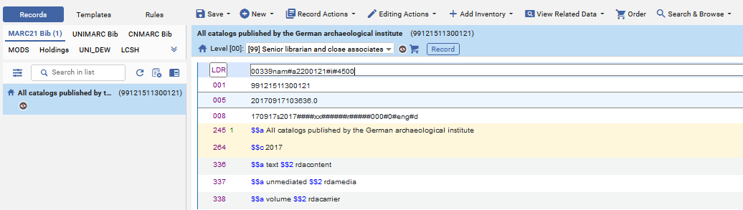
The Standing Order – A Live Demo
Create order for the suppressed record with title “All catalogs published by the German archaeological institute”
Suppressed
Create order

Slide 25
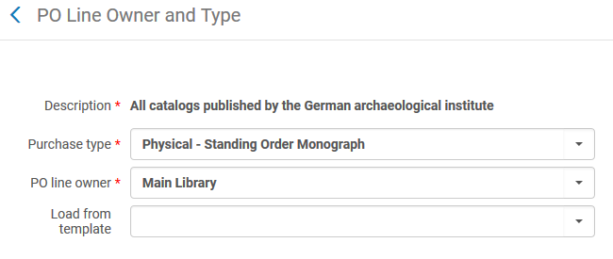
The Standing Order – A Live Demo
Here we create the order (POL-44573) and choose Purchase Type “Physical – Standing Order Monograph”

Slide 26
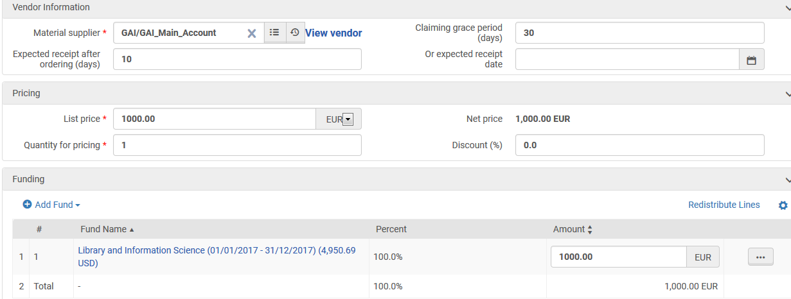
The Standing Order – A Live Demo
In the order price enter the amount which you want to be encumbered on the budget(s) used for this order. This will likely be the amount which you think the series of items will eventually cost.

Slide 27
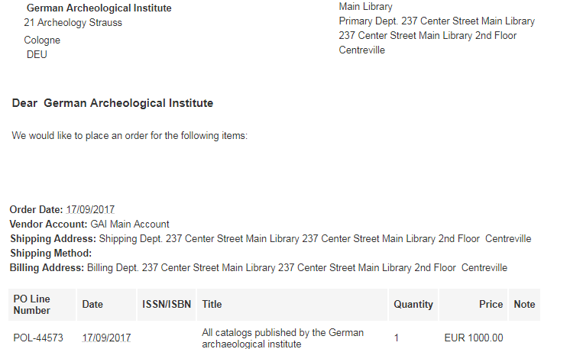
The Standing Order – A Live Demo
The order is sent to the vendor

Slide 28
The Standing Order – A Live Demo
The first pamphlet arrives for the standing order.
It is “A report on the archaeological findings in and under the Town Hall Square in Cologne, Germany”.
The bibliographic record, holding record and item are added.
In the item record enter the receiving date and link it to the POL.

Slide 29
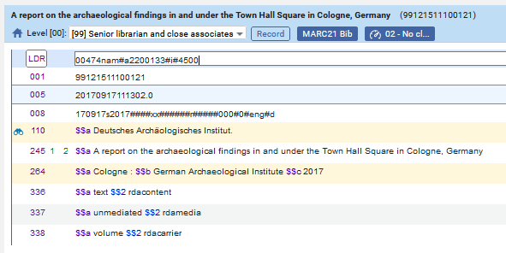
The Standing Order – A Live Demo
Here we add the Bibliographic record

Slide 30
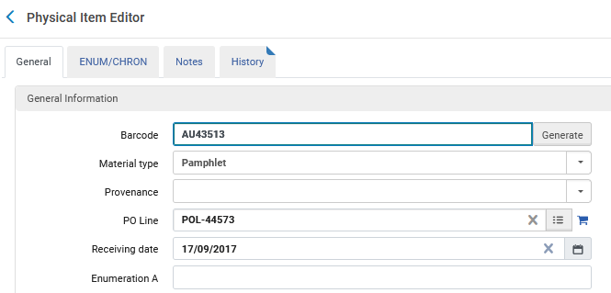
The Standing Order – A Live Demo
Here we add the item and then link the item to the PO Line of the standing order and add the Receiving Date
POL of the standing order

Slide 31
The Standing Order – A Live Demo
At some later point another record arrives for the standing order.
As was done for the first order we catalog it, add a holding record and an item. We link the item to the same standing order POL.
The pamphlet that arrives now is “Archaeological discoveries of the Ubii village on the Rhine”

Slide 32
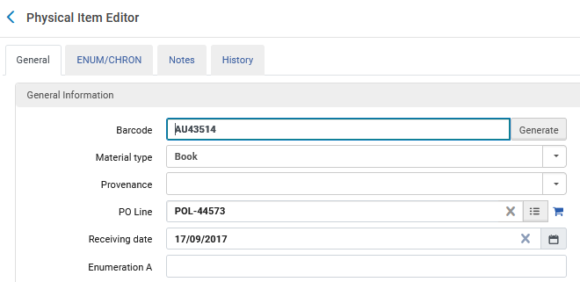
The Standing Order – A Live Demo
As with the previous item which already arrived for the standing order, we link this item to the standing order and add the receiving date
POL of the standing order

Slide 33
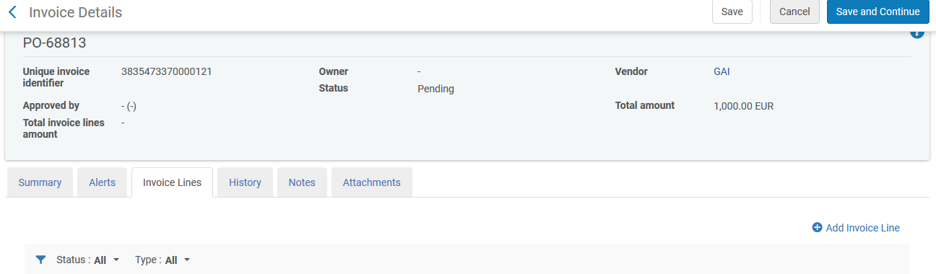
The Standing Order – A Live Demo
When invoice arrives pay for each item which arrived as part of the standing order using a separate invoice line for each item

Slide 34
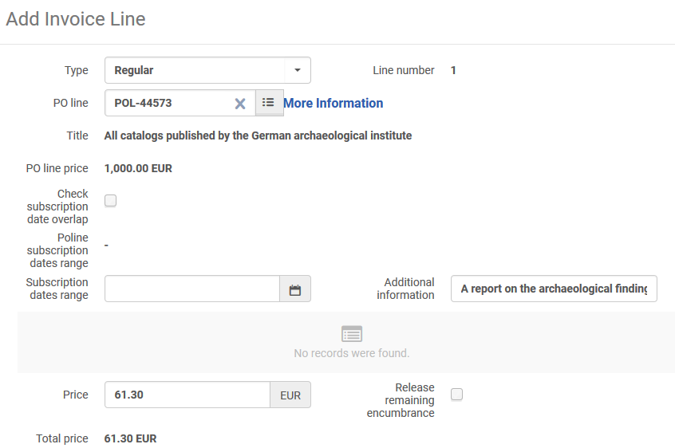
The Standing Order – A Live Demo
The first item of the standing order in first invoice line
POL of the standing order
Uncheck “Check subscription date overlap
Title and price of first item

Slide 35
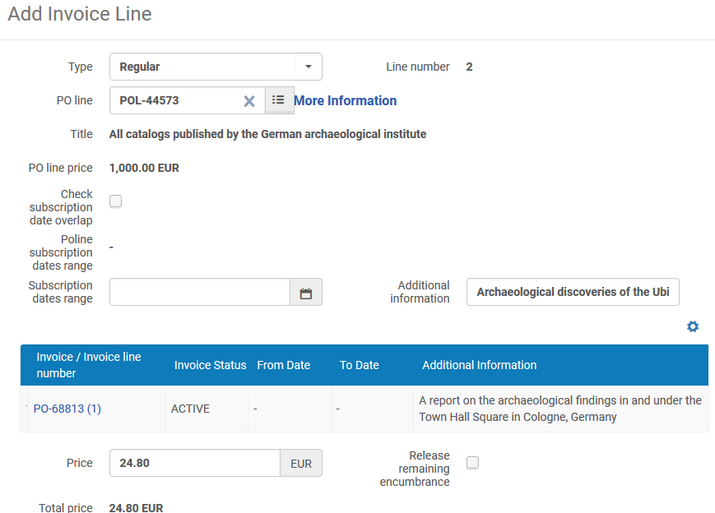
The Standing Order – A Live Demo
The second item of the standing order in first invoice line
POL of the standing order
Uncheck “Check subscription date overlap
Title and price of second item

Slide 36
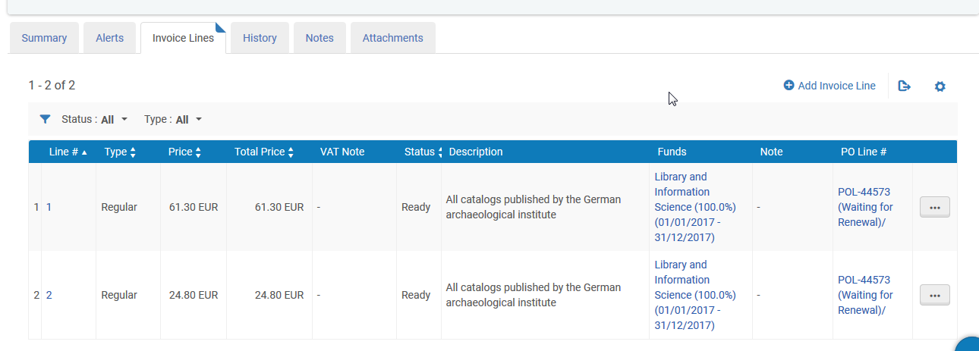
The Standing Order – A Live Demo
Here are both invoice lines

Slide 37
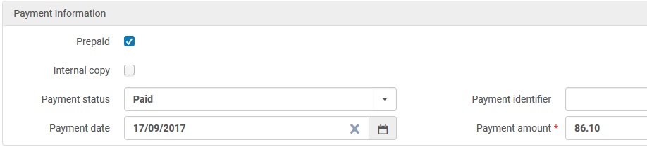
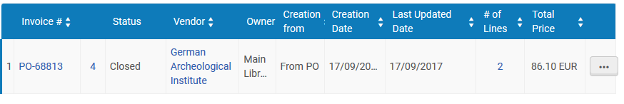
The Standing Order – A Live Demo
Pay the invoice I whatever manner you would normally pay the invoice
Sum of all invoice lines

Slide 38
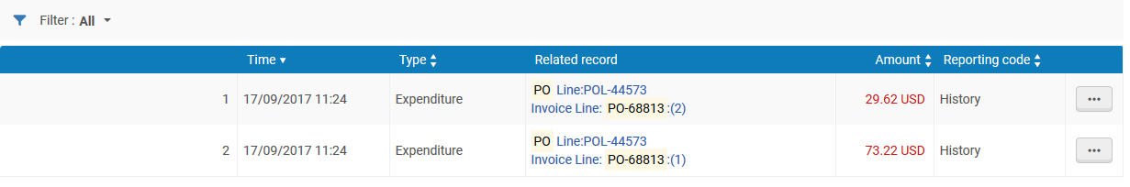
The Standing Order – A Live Demo
In the fund transactions you can see each separate expenditure for each separate item of the same standing order
POL of the standing order
First item and second item
In this specific case price is converted from EUR to USD

Slide 39
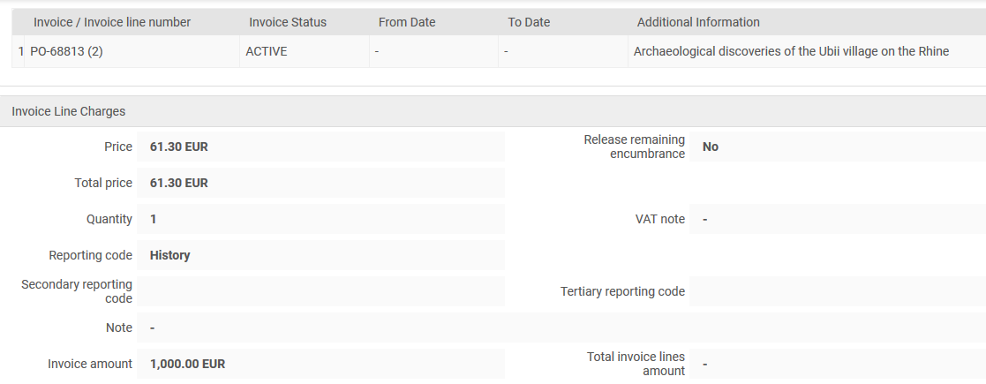
The Standing Order – A Live Demo
For example, this is the invoice line of the first item

Slide 40
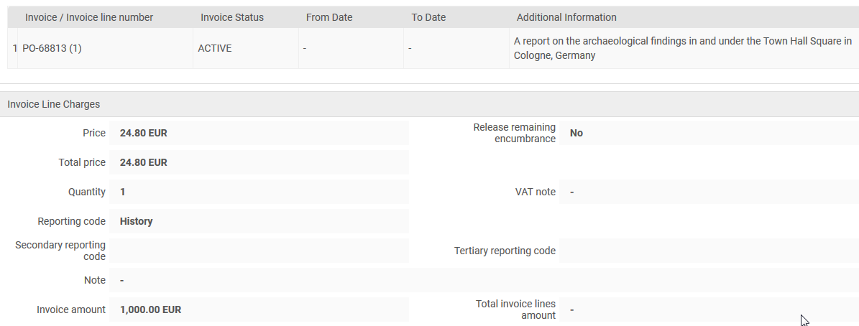
The Standing Order – A Live Demo
For example, this is the invoice line of the second item

Slide 41
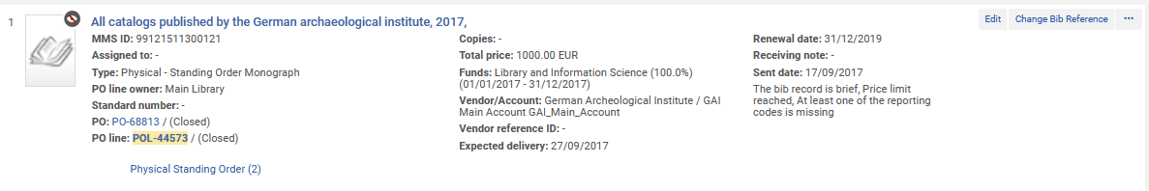
The Standing Order – A Live Demo
When the vendor will no longer be sending items for the standing order it should be manually closed.

Slide 42
The Standing Order for Electronic Resources

Slide 43
The Standing Order for Electronic Resources
If the standing order had been for electronic resources, then it would behave exactly like the example done here for physical resources, except for two changes:
The purchase type would be “Electronic title – Standing Order” instead of “Physical – Standing Order”
Instead of creating an item and linking the item to the standing order POL an electronic portfolio would be created and linked to the POL

Slide 44
The Standing Order for Electronic Resources
The rest of the workflow would be identical.
It may be advisable, depending on the specific case, to make one electronic collection for the standing order and make each portfolio part of that electronic collection.
  In this case the electronic collection will not be part of the PO Line with of type "Standing Order". The electronic collection will exist for organizational purposes, having all of the specific portfolios in one electronic collection.
In this case a non-suppressed bibliographic record connected to the electronic collection might be used.

Slide 45
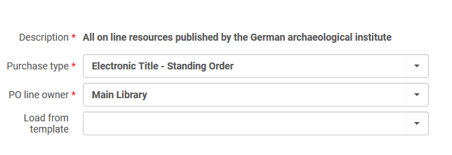
The Standing Order for Electronic Resources
The purchase type would be “Electronic title – Standing Order” instead of “Physical – Standing Order”.

Slide 46
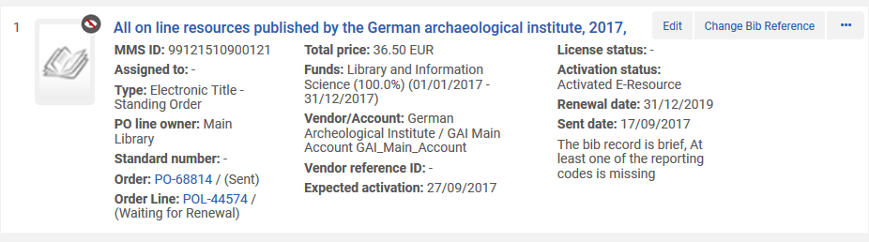
The Standing Order for Electronic Resources
This is POL-55474.
Title is “All on line resources published by the German archaeological institute”

Slide 47
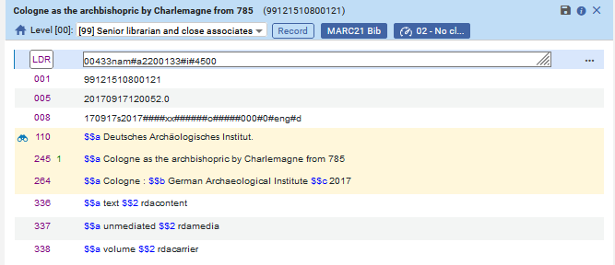
The Standing Order for Electronic Resources
For example here is bibliographic record for electronic portfolio “Cologne as the archbishopric by Charlemagne from 785”. It will be part of this electronic title standing order.

Slide 48
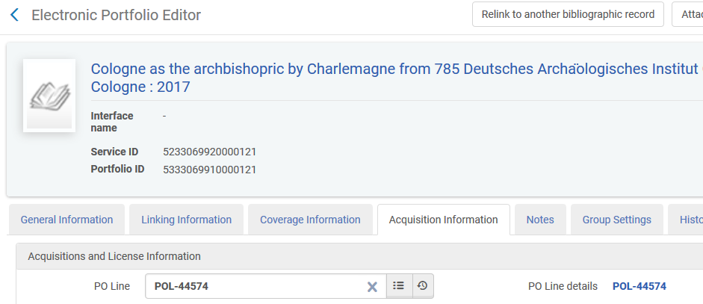
The Standing Order for Electronic Resources
Instead of creating an item and linking the item to the standing order POL an electronic portfolio is created and linked to the POL

Slide 49
The Standing Order for Electronic Resources
The rest of the flow is the same.
As stated, the only difference between “Electronic Title – Standing Order” and “Physical Title – Standing Order” is that:
“Electronic Title – Standing Order” has an electronic portfolio which is linked to the standing order
“Physical Title – Standing Order” has a physical item which is linked to the standing order.

